Slide 1



ST Financials
Team 1 - Sundara Travels

Slide 2

Problem Statement
& Proposed Solution
Work Flow
Modules
Tech Stack
Snapshots

Slide 3


ST Financials
provides efficient and fast
solution for loan application by compiling user's
financial data from multiple sources via OTP
consent for both banks & customers. It also provides
AI learnt predictions & analytics dashboards for
user's convinience.

Slide 4


AI Solution
In addition to providing aggregations, we use ML algorithms to provide a prediction for the approval of the loan.
Classification Algorithms like XGBoost, KNN and Decision Tree is used for giving a loan prediction with nearly 90% accuracy.

Slide 5
Two ML models are trained to predict the loan approval and credit risk of the applicant. The models are fully deployed in IBM Cloud:
Home Loan Prediction - Decision Tree
2. Education Loan Prediction - Random Forest
When the user provides consent for aggregation, the data is automatically fetched from the MySQL database to make the appropriate prediction based on type of loan applied.

Slide 6
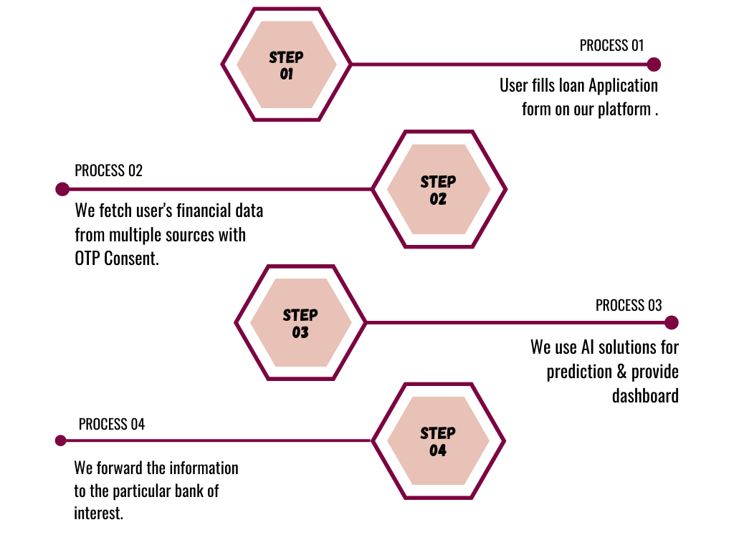


Slide 7
Modules
MySQL
Dashboard
ML models
OTP consent
Bank Login
Login Interface
& Loan Forms

Slide 8
Login & Forms
We have integrated the login functionality with required validations. The user has the option of choosing between education and student loans.
Bank Login
ST Financials does not only provide customers with ease of work but also for the banks. The bank administrator can login and view/approve the pending loan applications on our platform!

Slide 9

OTP Consent
We are utilising Twilio for sending the OTP via SMS to the user. Each time the OTP is stored in the database and validation check is done to confirm the identity.

Slide 10
MySQL Database
For the purpose of this development, the data was mirrored in MySQL
database and we used SQL queries for convinient data transfers.
My Models
As mentioned before, AI solutions consist of predictions for education and home loans. The models are successfully deployed in IBM Cloud.

Slide 11
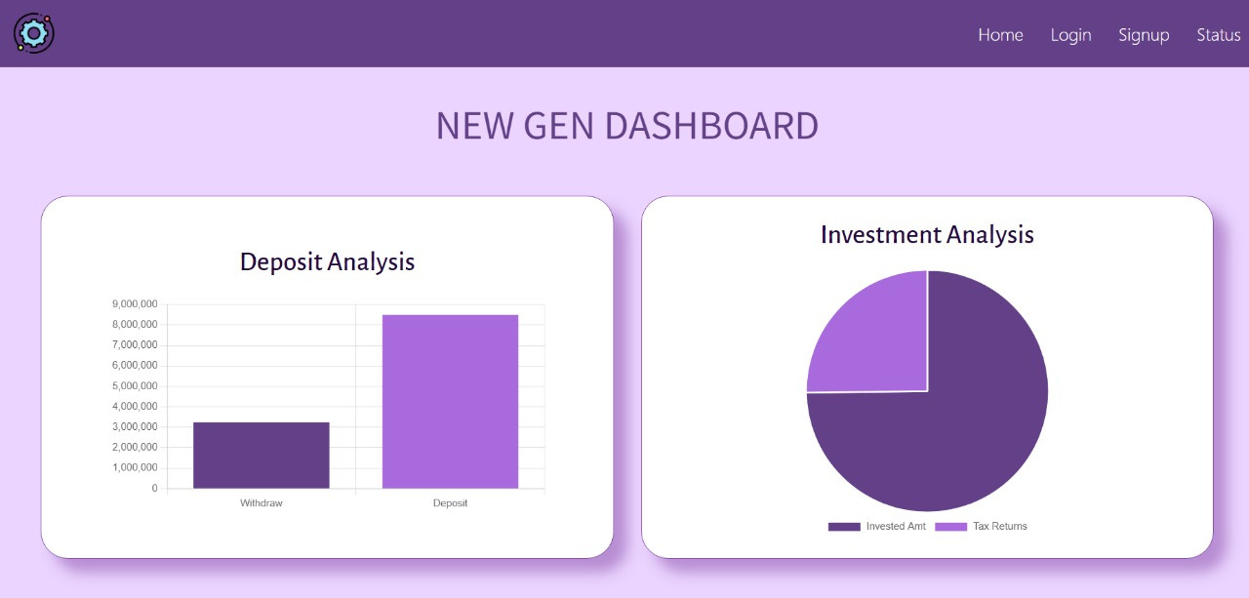
Dashboard
One of the most avant-garde feature is to represent the aggregated data in an interactive dashboard for user and bank convinience. We used react-chart.js for achieving this task. Many figures, plots and graphs are depicted based on retrieved data.

Slide 12

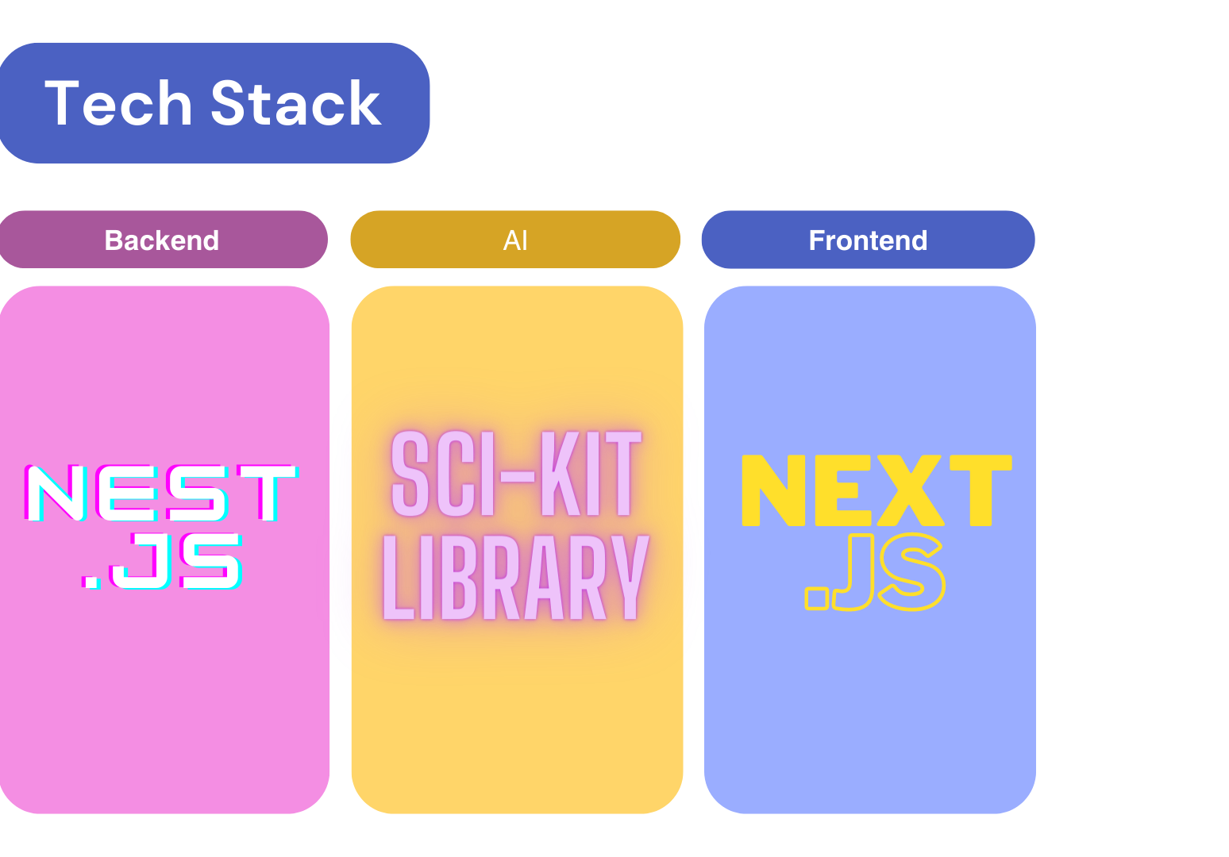
JavaScript
Postman
Python
IBM Deployment
JavaScript
Tailwind

Slide 13
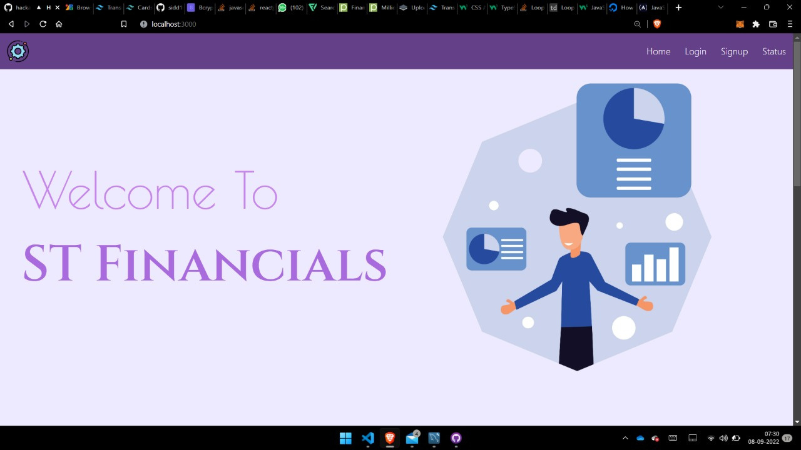
Snapshots

Slide 14
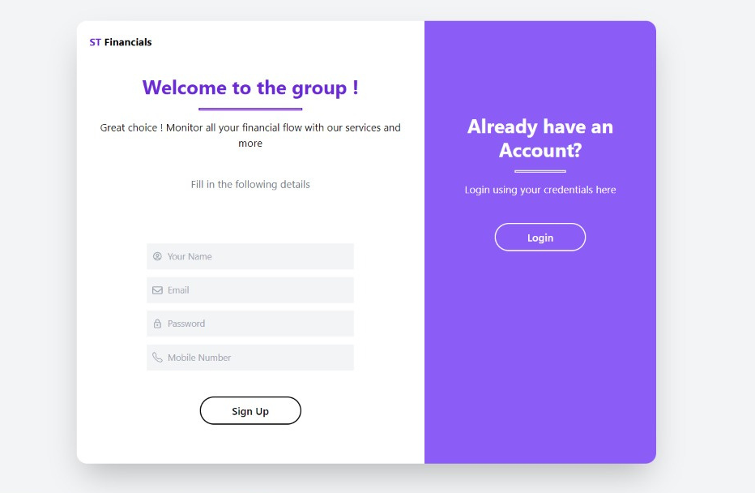

Slide 15
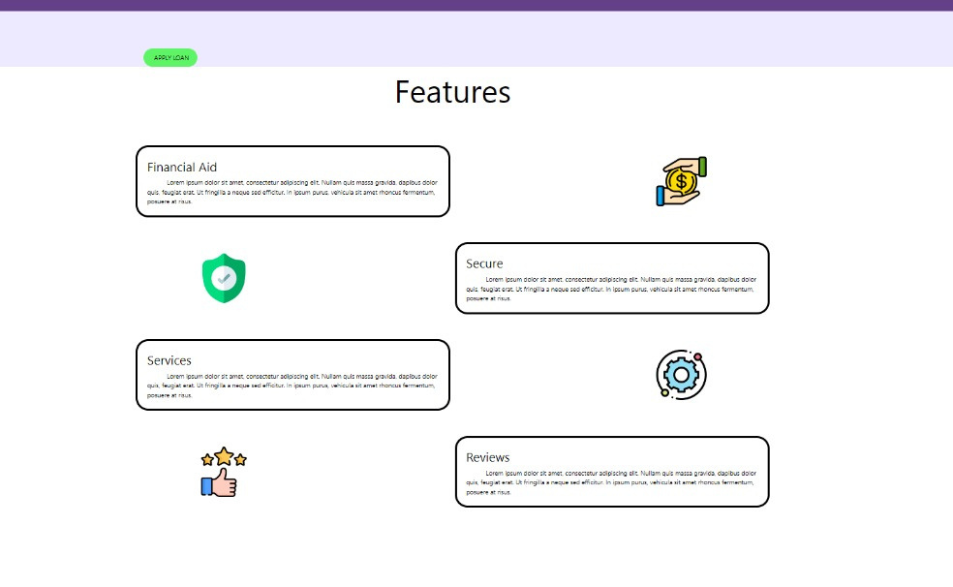

Slide 16
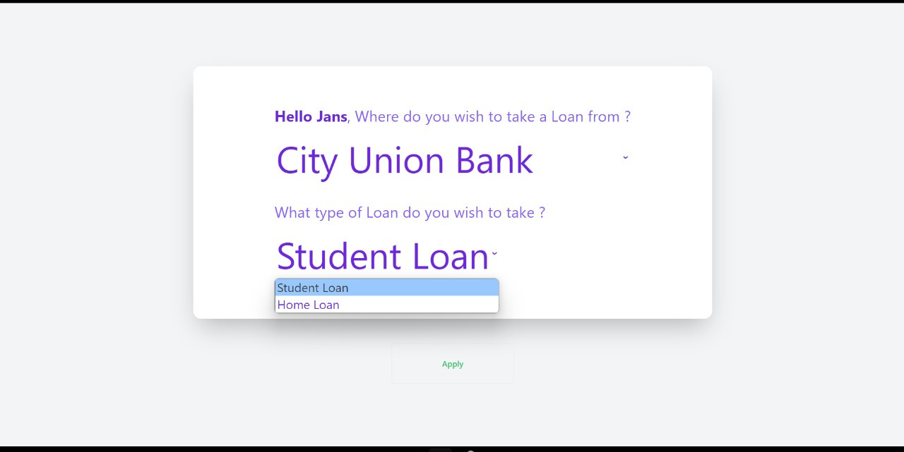

Slide 17
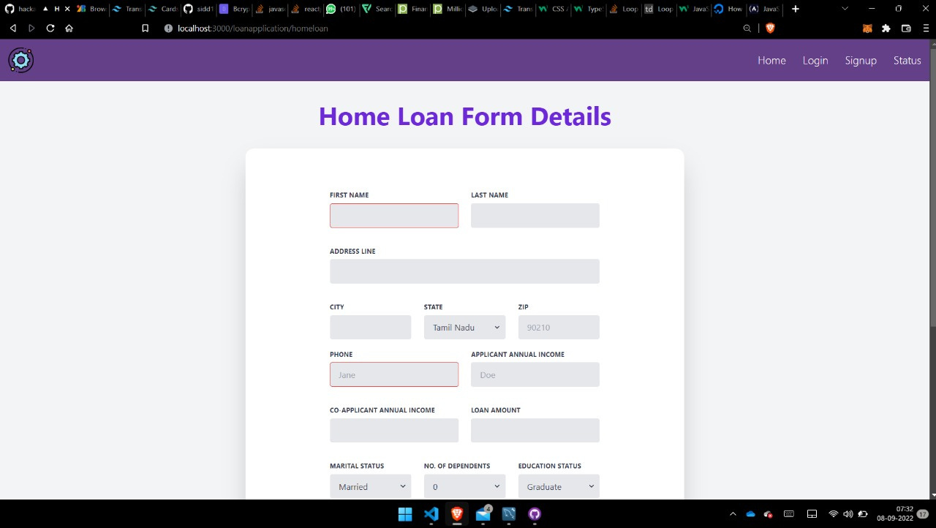

Slide 18
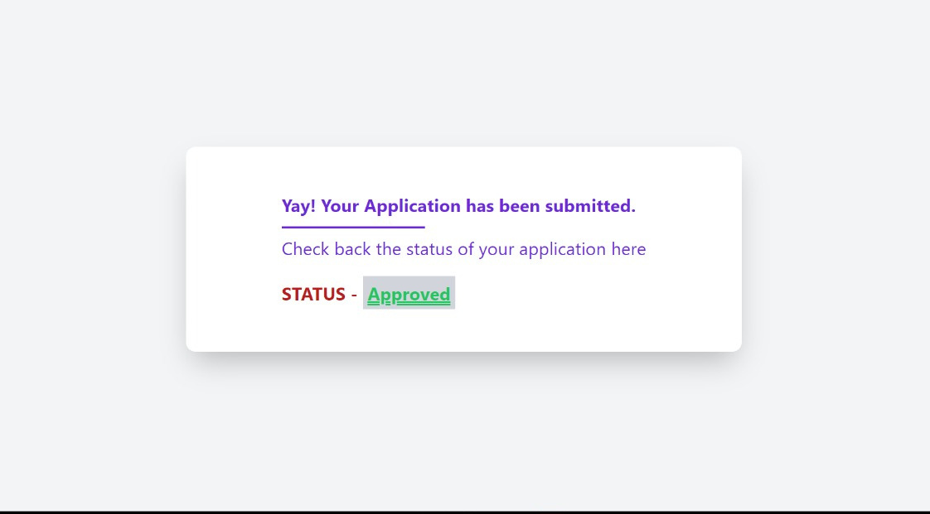

Slide 19
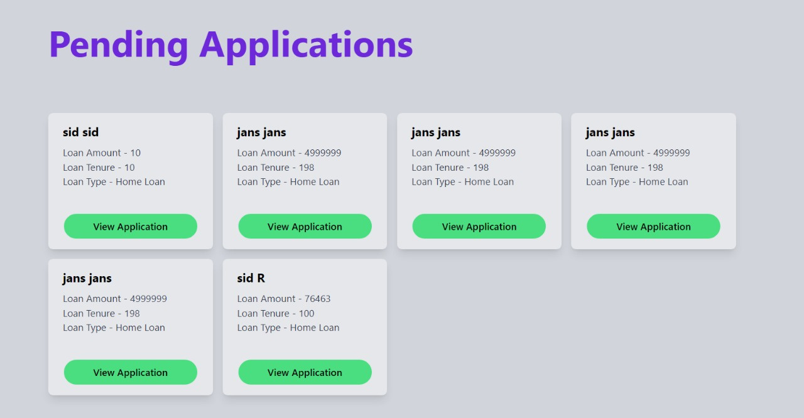

Slide 21
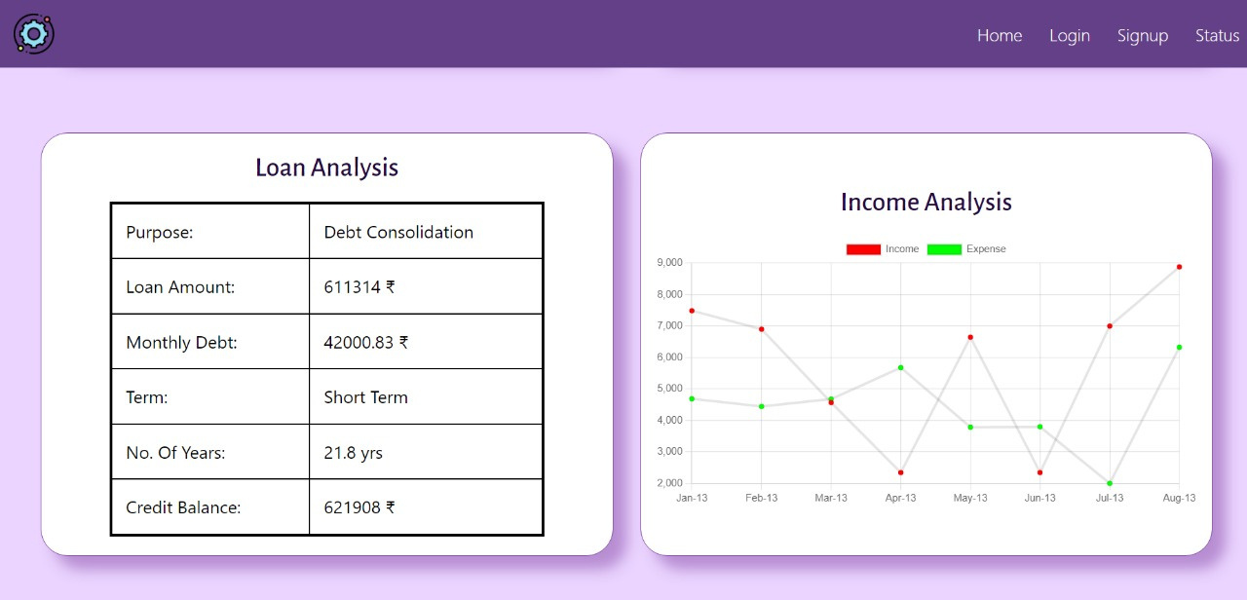

Slide 22
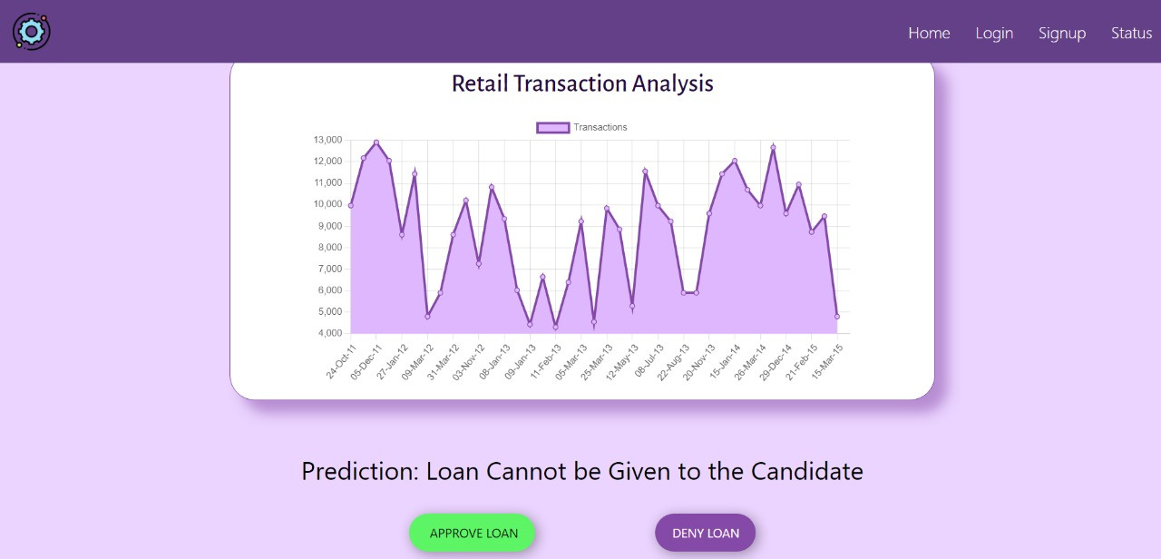

Slide 23
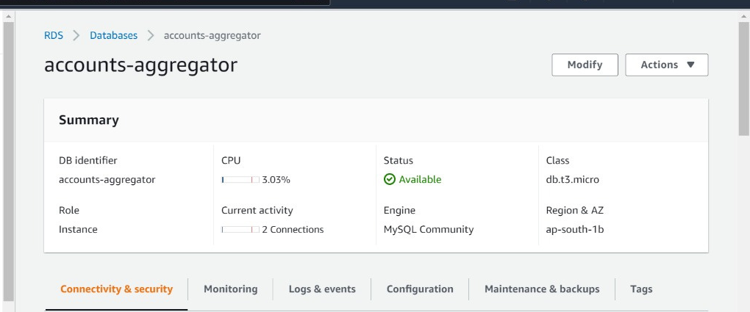

Slide 24
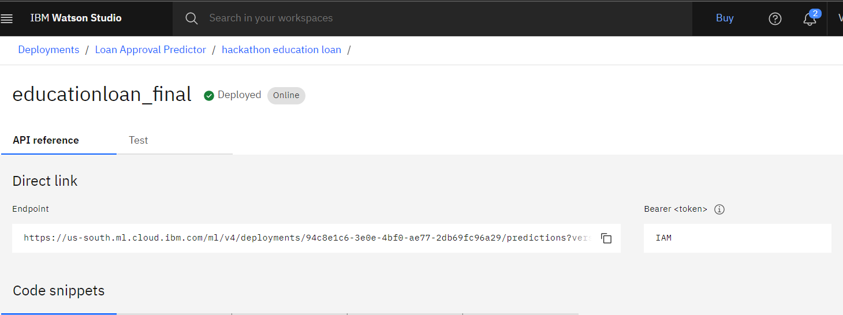

Slide 25
Thank You
SIDDHARTH R
ROGHAN
VAIBHAV THALANKI
JANAKI RAMAN

